Slide 1
Version control
Brian Caffo, Jeff Leek, Roger Peng
@bcaffo
www.bcaffo.com

Slide 2
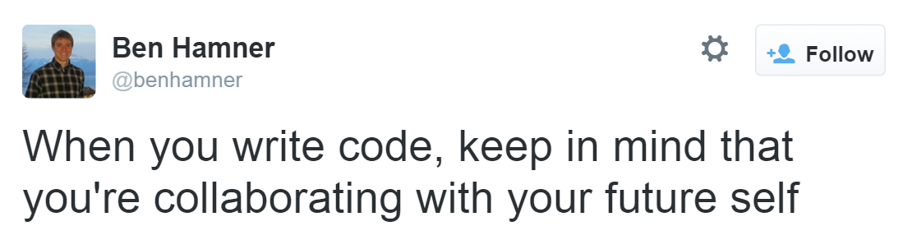

Slide 3
Everyone is using subversion; you’ve got to switch
Roger Peng

Slide 4

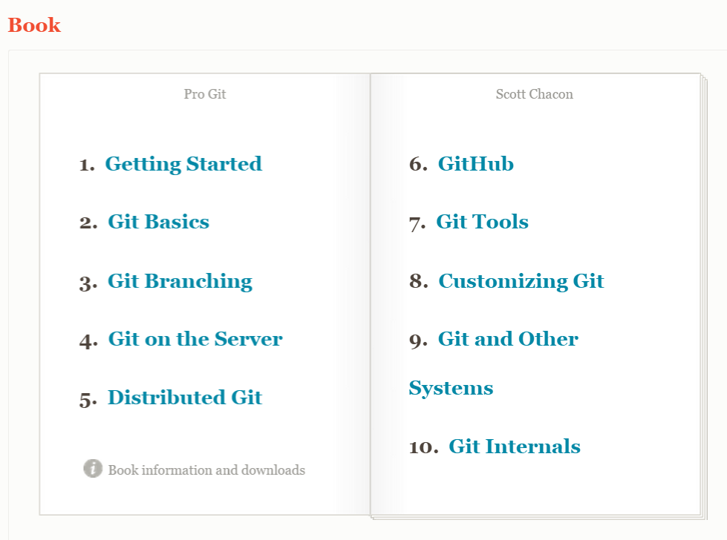
Git

Slide 5

Hosting services

